Slide 1
Political and constitutional developments (1959-1971)
1962 constitution
Reforms introduced by Ayub
Elections under Basic Democracies system
Agricultural Reforms
1965 war
Tashkent Declaration 1966
Mujib Six points and Agartala conspiracy
Yahya Khan and separation of East Pakistan (1969-1971)

Slide 2
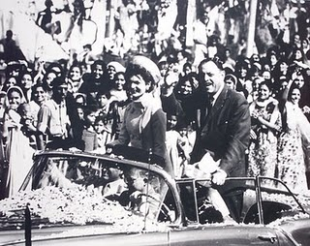
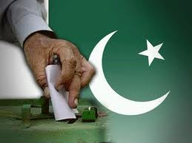
1962 Constitution
The Commission submitted its report on 29th April 1961 and on the basis of this report 1962 Constitution was framed and given on 1st March 1962
General elections under 1962 Constitution were held on 28th March 1962

Slide 3
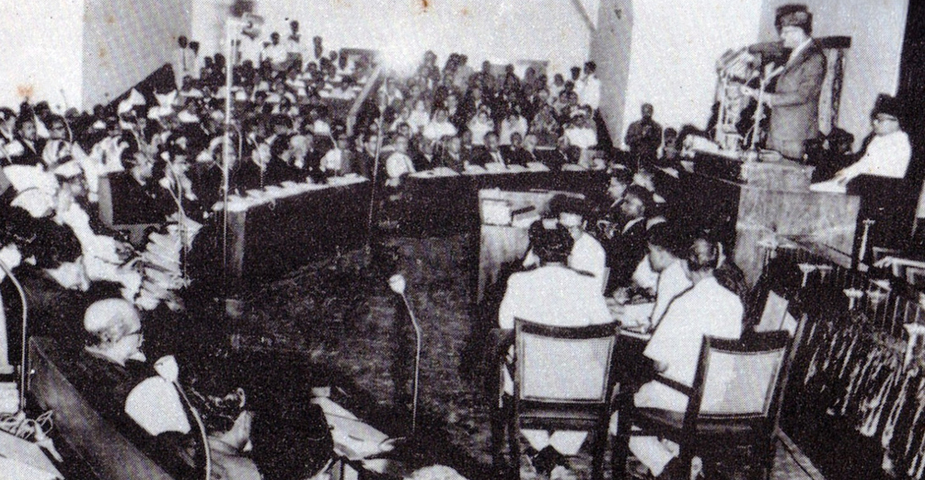
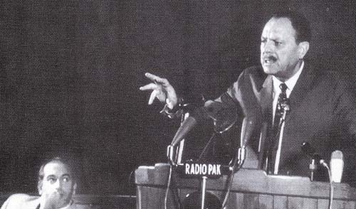
1962 Constitution envisaged a Federal State with Presidential form of Government and unicameral legislature
The electoral system was made indirect, and “basic Democrats” for both wings were declared Electoral Collage for electing the Assemblies and President

Slide 4
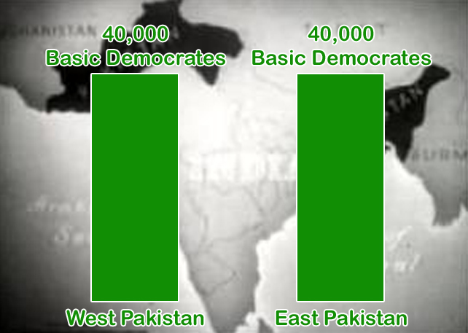
Basic democrats were 80,000 (40,000 from each province)
One of the major initiatives of this assembly was the passage of Political parties Act 1962

Slide 5
Reforms introduced by Ayub Khan
EBDO (elective body disqualification order)
The politicians who were alleged to be corrupt they were given two options either to face trial under the EBDO or voluntarily leave politics for 6 years.
PODO (public office disqualification order)
The corrupt bureaucrats were disqualified under this order
Land Reforms 1959
A person could not own more than 500 acres of irrigated and 1000 acres of unirrigated land, and 150 acres of orchard land.

Slide 6
Elections under Basic Democracies Order
In order to win the confidence of the Basic Democrats, Ayub Khan held elections in 1959. He won 95.6 % of the votes and became President.
The Basic Democracies Order became part of 1962 constitution. They were to become electoral college for electing the member of National Assembly and President.
The formation of assembly necessitated the need of political parties. Ayub Khan restored the political parties through political parties' act. Muslim League was divided into Muslim League Convention and Muslim League Council. Ayub Khan was part of Muslim League convention. It became official government party. In East Pakistan the Muslim League was already also broken and Suhrawardy made East Pakistan Awami Muslim league in 1950.

Slide 7
The Presidential elections were announced to be held in 1965.
The opposition forces has formed combined opposition parties to eliminate Ayub’s government. They nominated Fatima Jinnah as the Presidential candidate against Ayub khan.
Muslim League Council led by Khawaja Nazimuddin
Awami Muslim League led by Shiekh Mujibur Rehman
Awami National Party (East Pakistan) led by Maulana Bhashani and Wali Khan (NWFP)
Jamat-i-Islami led by Maulana Maudoodi.
The Basic Democracies were working on the pleasure of Ayub Khan due to which they voted in his favor and Fatima Jinnah lost the elections.

Slide 8
Agricultural reforms
SCARP (salinity control and reclamation program) this was intended to control the problems of water-logging and salinity
Tube wells were installs to extract the excess water out of the land.
Tractors were introduced
ADBP (agricultural development bank of Pakistan)
Provided loans to the peasants.
In 1960, Indus Water Treaty was signed as a result of which Mangla, Warsak, and Tarbela Dam was constructed. India gave compensation money and world bank also provide funds.
Hybrid seeds were introduced.
Pesticides and insecticides were introduced

Slide 9
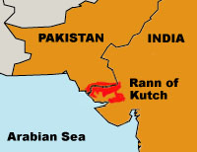

Slide 10
1965 war
The 1965 war was started due to Rann and Kutch conflict between Pakistan and India in which Pakistan gained control of some regions in Rann and Kutch.
India and China fought on the border region in 1962. Pakistan thought that it would be perfect time to take back the occupied territories of Kashmir.
Ayub khan launched operation Gibraltar with the hope that India position is vulnerable.
Pakistan infiltrated mujahedeen in the Indian Occupied region of Kashmir from working boundary (Sialkot-Jammu).
India recognized those mujahedeen who entered the region, and started advancing its troops across cease fire line
Pakistani troops also advanced in the cease fire line and the clashes started.

Slide 11
India launched attack on Pakistan through crossing the international boundary in Punjab.
The war was fought for almost 17 days from 6-23 September 1965
Tashkent agreement 1966
USSR intervened to bring cessation of the hostilities in between India and Pakistan
USSR Prime minister Alexi Kosygin invited Ayub and Indian Prime Minister Lal Bahadur Shastri to Tashkent to sign a peace agreement

Slide 12
Shiekh Mujib six points and Agartala conspiracy case.
Shiekh Mujib ur Rehman entered the politics in East Pakistan in the early 1950s. Suhrawardy has broken away from Muslim League and created East Pakistan Awami Muslim League in 1950. Shiekh Mujib was student leader in East Pakistan at that time.
The students in east Pakistan were also in the front line of the Bangla language movement.
Shiekh Mujib was appointed as the general secretary of the East Pakistan Awami Muslim League.
The issues such as the representation, and bangla language issue has been up to some extent incorporated in 1956 constitution, but the economic issue has not been addressed by West Pakistan.

Slide 13
East Pakistan was underrepresented in the Bureaucracy and army.
Jute was produced in large amount in East Pakistan. The total value of raw jute and jute manufacturers exported from East Pakistan was equal to half of the country’s export earnings. But this money did not benefit East Pakistan.
East Pakistan was left defenseless in 1965 war.
Mujib Six points 1966
Federal constitution for Pakistan
Central government should have defense and foreign policy only rest of the powers should be given to provinces.
Tax collection should be in the domain of provinces.
East Pakistan should have its own military.

Slide 14
Two provinces East and West Pakistan should have their separate currencies or restrictions should be imposed on the flight of capital from East to West Pakistan.
The Foreign exchange earned by East Pakistan should remain with East Pakistan
Agartala Conspiracy case 1968
Shiekh Mujib along with other ten people were accused of involved in conspiracy for independence of East Pakistan.
It was accused that these conspirators went to Agartala, a place in Sylhet, India for making plans for the creation of independent East Pakistan.
However, the Trial did not last long due to the emergence of anti-Ayub protest allover in Pakistan. Ayub was forced to withdraw the Agartala case.

Slide 15
Yahya Khan and separation of East Pakistan (1969-1971)
On 25th March Ayub khan declared that he is transferring power to General Yahya Khan instead of elections, who also became the chief of army staff
When Yahya khan assumed the reigns of government, he abrogated the 1962 constitution, banned all political activities, dismissed central and provincial assemblies and declared Martial law in the country.
The fundamental rights were suspended
There was a rise of discontentment and a sense of deprivation was assuming momentum in the East Pakistan.

Slide 16
It was declared that after the elections the constituent assembly has to frame constitution within 120 days of its first meeting. Otherwise the assembly would be dismissed
1970 general elections
Awami League was dominant political actor in the eastern wing of Pakistan.
It fought the elections on the six-point agenda of Shiekh Mujib.
In Western wing of Pakistan, Pakistan Peoples Party was the dominant political party. Zulfiqaur Ali Bhutto fought the elections on the concept of Islamic Socialism with the slogan of Roti, Kapra, Makan.
Awami league won all the seats in the Eastern Wing except 2 seats. On the other hand PPP won majority in the Western wing.

Slide 17
Transfer of power Mujib-Bhutto-Yahya
Mujib declared that he would make the six-point agenda part of the constitution
Mujib has kept the rebellious movement active it the eastern wing of Pakistan to keep the power of the people in order to negotiate with the government.
Bhutto declared that without the involvement of his party no constitution could be framed just based on the dictates of the majority party.
The session of the National Assembly was delayed due to the deadlock in between Bhutto and Mujib

Slide 18
Bhutto went Dhaka to negotiated with Mujib on 26th January 1971. However, Mujib remained adamant on his demand of six point agenda to be made the part of the constitution.
Yahya Khan postponed the assembly session because Bhutto said that if the session of assembly took place he would launch a great movement in the West Pakistan.
On 2nd March 1970, Mujib launched civil disobedience movement in the eastern wing of the country.
Yahya khan called a meeting of the 12 elected members from the two wings of the country to decide the date for the session of the National assembly.
Yahya khan decided that the session of the national assembly would held in Dhaka on 25th March, 1971.

Slide 19
Mujib demanded to lift the martial law from the country, transfer the power to the elected representatives of the people, and stop military build up from the Eastern Wing of the country.
Civil War in Eastern Pakistan
It was not accepted as a result of Awami league decided to declare independence from the West wing of Pakistan on 24th March, 1971.
Yahya khan ordered the military to bring the law-and-order situation to normalcy. Mujib and other political leaders were arrested, as a result of which civil war was started in the East Pakistan.
The onset of the civil war compelled large number of people to take refuge in India.
This provided India an opportunity to intervene and resolve the civil war.

Slide 20
In November, 1971, Indian troops crossed the border, and assisted the Mukti-Bahini (independence Guerilla forces) to launch attacks against Pakistani troops.
On 3rd December, 1971 a war started between India and Pakistan. The war was fought on the border between West Pakistan and India and in the Kashmir valley.
On 16th December 1971 the East Pakistan became independent.

